Slide 1
Challenges driving Industry 4.0 with IIoT/AI
Michael Gardiner, P.Eng
Manufacturing Industry Executive
Microsoft Canada

Slide 2
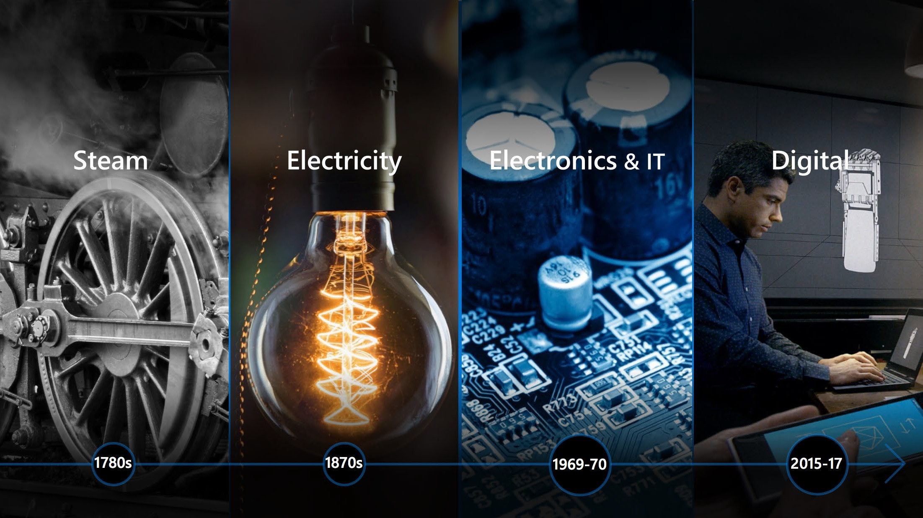

I4.0 = personalizing products (& services) at scale
1.0
Mechanized production Steam power
2.0
Mass production Electricity
3.0
Automation IT
4.0
Cyber-physical systems
1780s
1870s
1970s
2012+
Notes:
OLD WORLD
Information scarce
Static hierarchies
Siloed productivity
Customers
Focus on planning ahead
Transactional Systems
NEW WORLD
Information abundant
Dynamic networks
Collective value creation
Brand Ambassadors
Experiment, learn and respond
Systems of Intelligence
1. Steam
Manufacturing production more efficient thanks to steam engines and hydraulic power in factories.
2. Electricity
Mass production possible thanks to electricity and assembly lines.
3. Electronics and IT
Computing advances enable programming of machines and networks.
4. Digital
Connect data from digital and physical world to drive insights and solve business challenges.

Slide 3
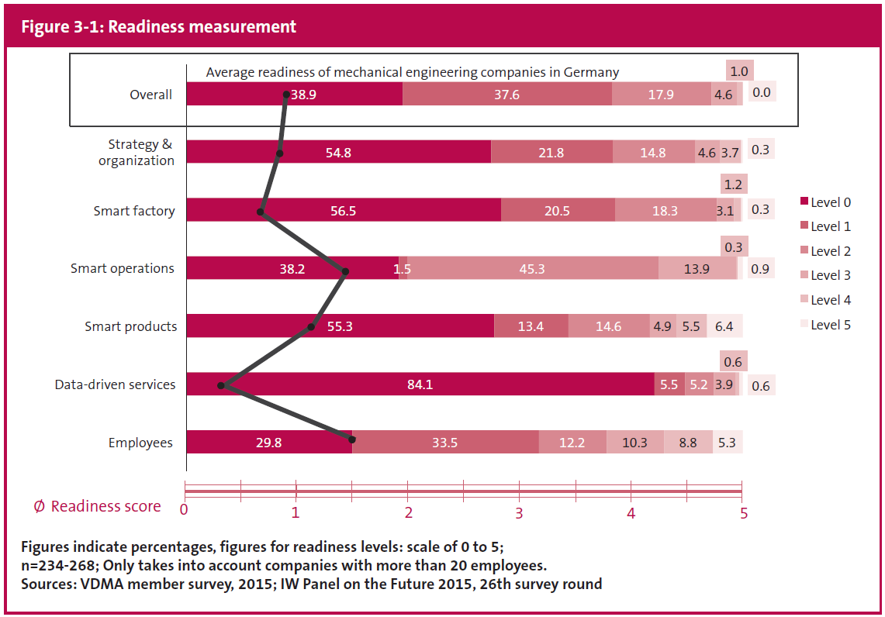
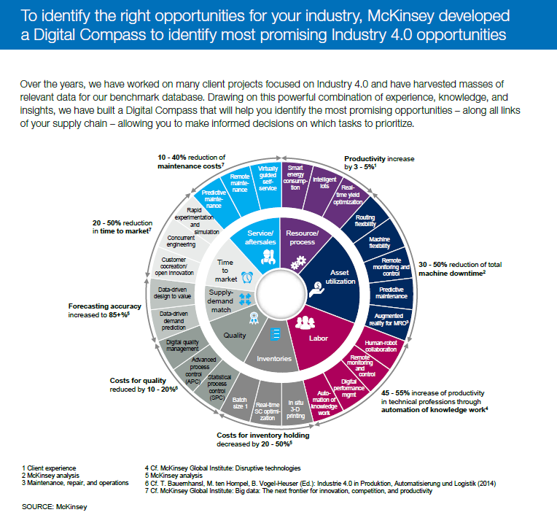
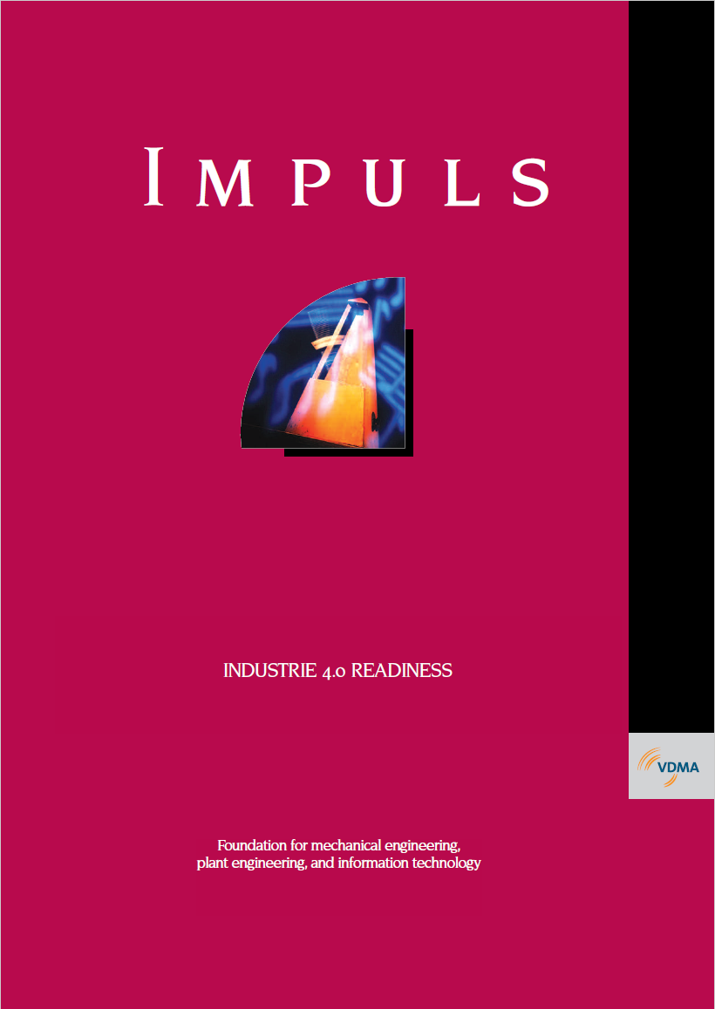
Guidance for companies pursuing Industry 4.0
Many capability models define maturity levels; however, implementation ROI ambiguous
Strategies prioritize based on value, but limited implementation guidance

Slide 4
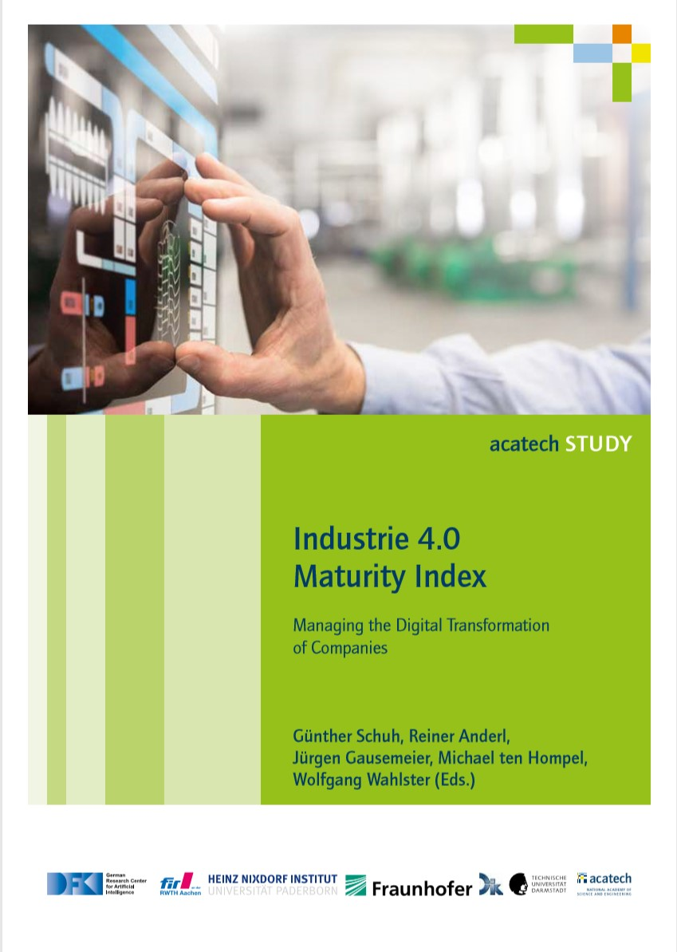
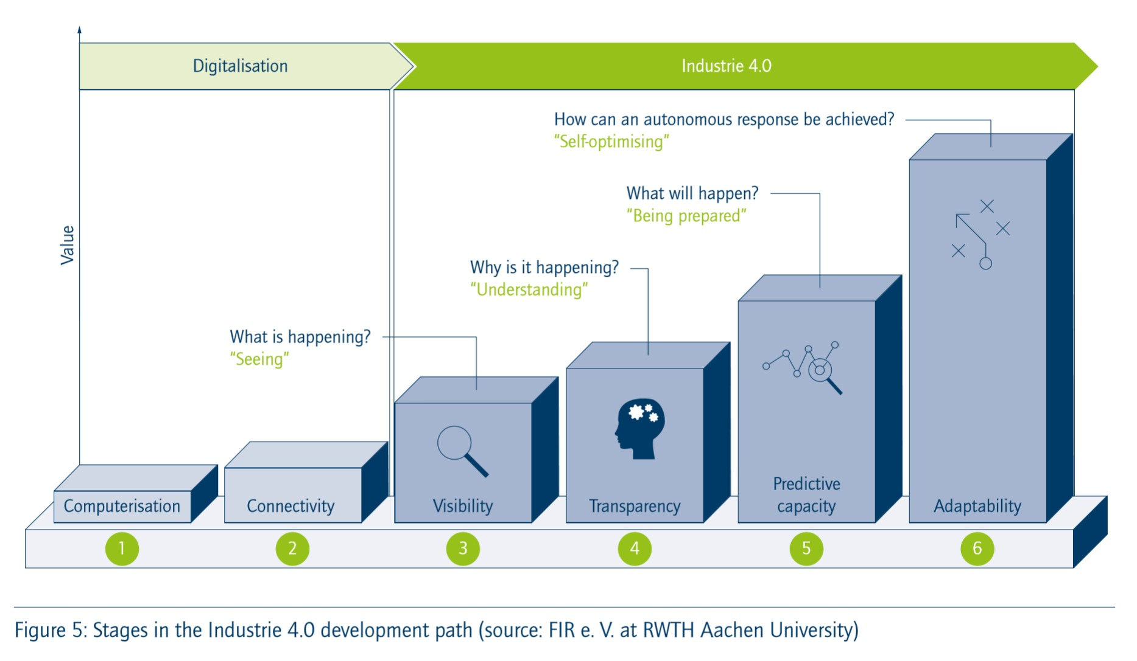
Our 7-step process is derived from an I4.0 Acatech Study…
Cognitive
Enhance margins
Optimize pricing
Improve NPI
Predictive
Value
Reduce conversion costs
Decrease lead times
Improve service levels
3
“New services & business models”
Connected
Enhance productivity
Improve quality
Reduce inventory
“Real-time data driven response”
Cognitive & Intelligent Connected Products
2
“Predicting what will happen”
Digital Feedback Loop, Automation
1
“Understanding causes & impacts”
AI Models,
Machine
Learning
Phase
“See what is happening”
Advanced Analytics
“Define data and sources”
“Get connected”
Data Visualization
Data
Foundation
Equipment & Factory
Monitoring
Data
Analytics
AI
Cognitive
Time

Slide 5
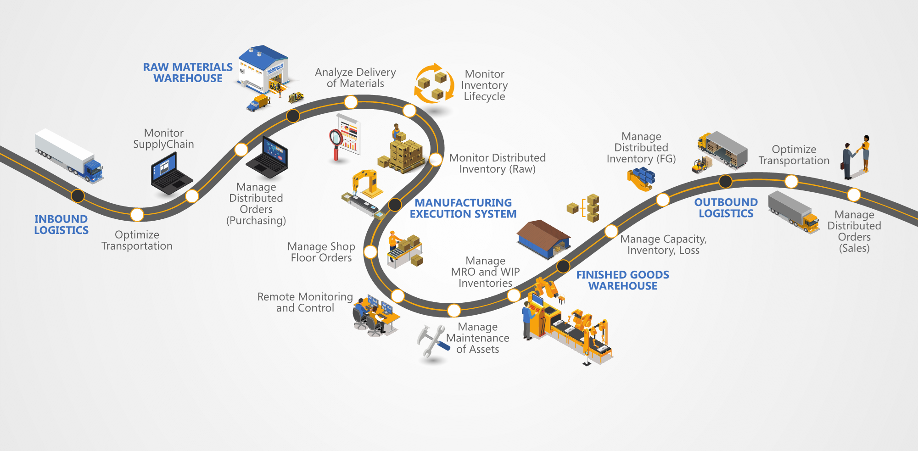
But many shop floor processes are highly interdependent
∆
∆
∆
∆
∆
∆

Slide 6
And they rarely stay the same for long
Routing / Bill of Process
Station 1: Operation 1 (Manufacturing Processing)
Station 2: Operation 2 (Quality Check)
Delivery Storage: Operation 3 (Material Movement)
Machine Process Data (Azure IoT)
Camera Image (Azure IoT)
PowerApps Classification (CDS)
Logistics Tracking (Azure IoT)
Location Data (Azure Maps)
Inventory Data (ERP)
MES/SCADA System
Part#A Rev1, Serial 1A
Operation 1, Rev1
Machine P = 100psi = Good Part
Visual Inspection System
Part#A Rev1, Serial 1A
Operation 2, Rev1
Image = Good Part
IoT Location System
Part#A Rev1, Serial 1A
Operation 3 Rev1: Good
Storage Location 1, Inventory +1
AIop1 Rev 1 for Part#A Rev 1
Operation 1, Rev1
AIop2 Rev 1 for Part#A Rev 1
Operation 1, Rev1 +
Operatino 2, Rev1
Notes:
MES = Manufacturing Execution Systems
Kaizen = CI = Continuous Improvement
Engineering Changes are regularly occurring as a byproduct of product or process improvements

Slide 7
And they rarely stay the same for long: Kaizen / Constant Change
Routing / Bill of Process
Station 1: Operation 1 (Manufacturing Processing)
Station 2: Operation 2 (Quality Check)
Delivery Storage: Operation 3 (Material Movement)
Machine Process Data (Azure IoT)
Camera Image (Azure IoT)
PowerApps Classification (CDS)
Logistics Tracking (Azure IoT)
Location Data (Azure Maps)
Inventory Data (ERP)
MES/SCADA System
Part#A Rev1, Serial 1A
Operation 1, Rev1
Machine P = 100psi = Good Part
Visual Inspection System
Part#A Rev1, Serial 1A
Operation 2, Rev1
Image = Good Part
IoT Location System
Part#A Rev1, Serial 1A
Operation 3 Rev1: Good
Storage Location 1, Inventory +1
AIop1 Rev 1 for Part#A Rev 1
Operation 1, Rev1
AIop2 Rev 1 for Part#A Rev 1
Operation 1, Rev1 +
Operatino 2, Rev1
MES/SCADA System
Part#A Rev1, Serial 1B
Operation 1, Rev2
Machine P = 120psi = Good Part
Visual Inspection System
Part#A Rev1, Serial 1A
Operation 2, Rev1
Image = Good Part
IoT Location System
Part#A Rev1, Serial 1A
Operation 3 Rev1: Good
Storage Location 1, Inventory +1
AIop1 Rev 2 for Part#A Rev 1
Operation 1, Rev2
AIop2 Rev 2 for Part#A Rev 1
Operation 1, Rev2 + Operation 2, Rev1
Process/Setup Improvement
Notes:
MES = Manufacturing Execution Systems
Kaizen = CI = Continuous Improvement
Engineering Changes are regularly occurring as a byproduct of product or process improvements

Slide 8
And they rarely stay the same for long: Kaizen / Constant Change
Routing / Bill of Process
Station 1: Operation 1 (Manufacturing Processing)
Station 2: Operation 2 (Quality Check)
Delivery Storage: Operation 3 (Material Movement)
Machine Process Data (Azure IoT)
Camera Image (Azure IoT)
PowerApps Classification (CDS)
Logistics Tracking (Azure IoT)
Location Data (Azure Maps)
Inventory Data (ERP)
MES/SCADA System
Part#A Rev1, Serial 1A
Operation 1, Rev1
Machine P = 100psi = Good Part
Visual Inspection System
Part#A Rev1, Serial 1A
Operation 2, Rev1
Image = Good Part
IoT Location System
Part#A Rev1, Serial 1A
Operation 3 Rev1: Good
Storage Location 1, Inventory +1
AIop1 Rev 1 for Part#A Rev 1
Operation 1, Rev1
AIop2 Rev 1 for Part#A Rev 1
Operation 1, Rev1 +
Operatino 2, Rev1
MES/SCADA System
Part#A Rev1, Serial 1B
Operation 1, Rev2
Machine P = 120psi = Good Part
Visual Inspection System
Part#A Rev1, Serial 1A
Operation 2, Rev1
Image = Good Part
IoT Location System
Part#A Rev1, Serial 1A
Operation 3 Rev1: Good
Storage Location 1, Inventory +1
AIop1 Rev 2 for Part#A Rev 1
Operation 1, Rev2
AIop2 Rev 2 for Part#A Rev 1
Operation 1, Rev2 + Operation 2, Rev1
Process/Setup Improvement
MES/SCADA System
Part#A Rev2, Serial 2A
Operation 1, Rev 3
Machine P = 130psi = Good Part
Visual Inspection System
Part#A Rev2, Serial 2A
Operation 2, Rev 2
Image Rev 2 = Good Part
IoT Location System
Part#A Rev2, Serial 2A
Operation 3, Rev 2
Storage Location 2, Inventory +1
AIop1 Rev 2 for Part#A Rev 2
Operation 1, Rev3
AIop2 Rev 3 for Part#A Rev 2
Operation 1, Rev3 + Operation 2, Rev2
AIop3 Rev 2 for Part#A Rev 2
Operation 1, Rev3 + Operation 2, Rev2 +
Operation 3, Rev2
Design Improvement
Notes:
MES = Manufacturing Execution Systems
Kaizen = CI = Continuous Improvement
Engineering Changes are regularly occurring as a byproduct of product or process improvements

Slide 9
Digital Thread(s) map out these relationships
Efficiency @ High Mix
Execution @ Place / Time
Process Definition “Digital Twin”
Materials Availability
Tool Readiness @Cell
Skilled Labour Availability
Recipe Version @ Operation
Process Version Definition / Bill of Process
Product Version Definition “Digital Twin”
Material Sequencing
Fast Changeover
Fast Calibration
Automated / Augmented
Closed Loop Feedback
Task Assistance
Real Time Sequencing
Timing/Problem Reporting
Real Time Sequence Changes
Auto Adjustment
Robotics / Automation
Material Delivery
Material Location Tracking
Automated Inventory Usage
Capacity
Options & Variant Management
Advanced Sequencing
Task Execution Tracking
Track & Trace
Machine Downtime Reporting
Task Execution TAKT Reporting
In Process Quality Checking
Zero Defect Quality
Detection
Containment
Mixed Reality
Process Guides
Automation Program
Task Guidance
Training
Scheduling
Expert Assistance
AI Assistance
Electronic Work Instructions
AI / Bot Assistance
Remote Assist
Agility at Scale Focus
Inventory Tracking
Config Management / PLM
BoM Management
CAD/CAM/CAE Data Management
Real Time Feedback
Fast Dial In
Signature Prediction / AI
AI / Machine Teaching Algorithms
Signature Analysis
Auto Containment
100% Inspection
Physics-Based Process Simulation
Real Time Process Data
Physics-Based Simulation Model
Real Time Controls / Sensor Data
Automated Inspection
Anomaly Detection
Vision / Data AI
IoT/Data Platform
Machine Connectivity
Shift Tracking
MRP/ERP
Forecasting
Training Data
Process Signature
Virtual Commissioning
Process Simulation / HiL / SiL
SCADA / Sensor / IoT Data
Capability Mapping Example:
Solving for Agility at Scale: aka “High Mix @ High Volume”
Box = Process Capability
Connector = Process Dependencies (Some cross-process dependencies not shown)
Notes:
>60 boxes, each may represent $M+ implementation projects

Slide 10
Entire categories of solutions support these capabilities
IoT/OEE Software
MES/MOM Software
Efficiency @ High Mix
Execution @ Place / Time
Process Definition “Digital Twin”
Materials Availability
Tool Readiness @Cell
Skilled Labour Availability
Recipe Version @ Operation
Process Version Definition / Bill of Process
Product Version Definition “Digital Twin”
Material Sequencing
Fast Changeover
Fast Calibration
Automated / Augmented
Closed Loop Feedback
Task Assistance
Real Time Sequencing
Timing/Problem Reporting
Real Time Sequence Changes
Auto Adjustment
Robotics / Automation
Material Delivery
Material Location Tracking
Automated Inventory Usage
Capacity
Options & Variant Management
Advanced Sequencing
Task Execution Tracking
Track & Trace
Machine Downtime Reporting
Task Execution TAKT Reporting
In Process Quality Checking
Zero Defect Quality
Detection
Containment
Mixed Reality
Process Guides
Automation Program
Task Guidance
Training
Scheduling
Expert Assistance
AI Assistance
Electronic Work Instructions
AI / Bot Assistance
Remote Assist
Agility at Scale Focus
Inventory Tracking
Config Management / PLM
BoM Management
CAD/CAM/CAE Data Management
Real Time Feedback
Fast Dial In
Signature Prediction / AI
AI / Machine Teaching Algorithms
Signature Analysis
Auto Containment
100% Inspection
Physics-Based Process Simulation
Real Time Process Data
Physics-Based Simulation Model
Real Time Controls / Sensor Data
Automated Inspection
Anomaly Detection
Vision / Data AI
IoT/Data Platform
Machine Connectivity
Shift Tracking
MRP/ERP
Forecasting
Training Data
Process Signature
Virtual Commissioning
Process Simulation / HiL / SiL
SCADA / Sensor / IoT Data
Capability Mapping Example:
Solving for Agility at Scale: aka “High Mix @ High Volume”
DNC System
Enterprise PLM Software
Real Time Location Systems
AI Forecasting
Process Simulation Software
Box = Process Capability
Connector = Process Dependencies (Some cross-process dependencies not shown)
IoT/AI Process Control / BONSAI
Remote Assist Solution
IoT/ Vision AI / Defect Detection

Slide 11
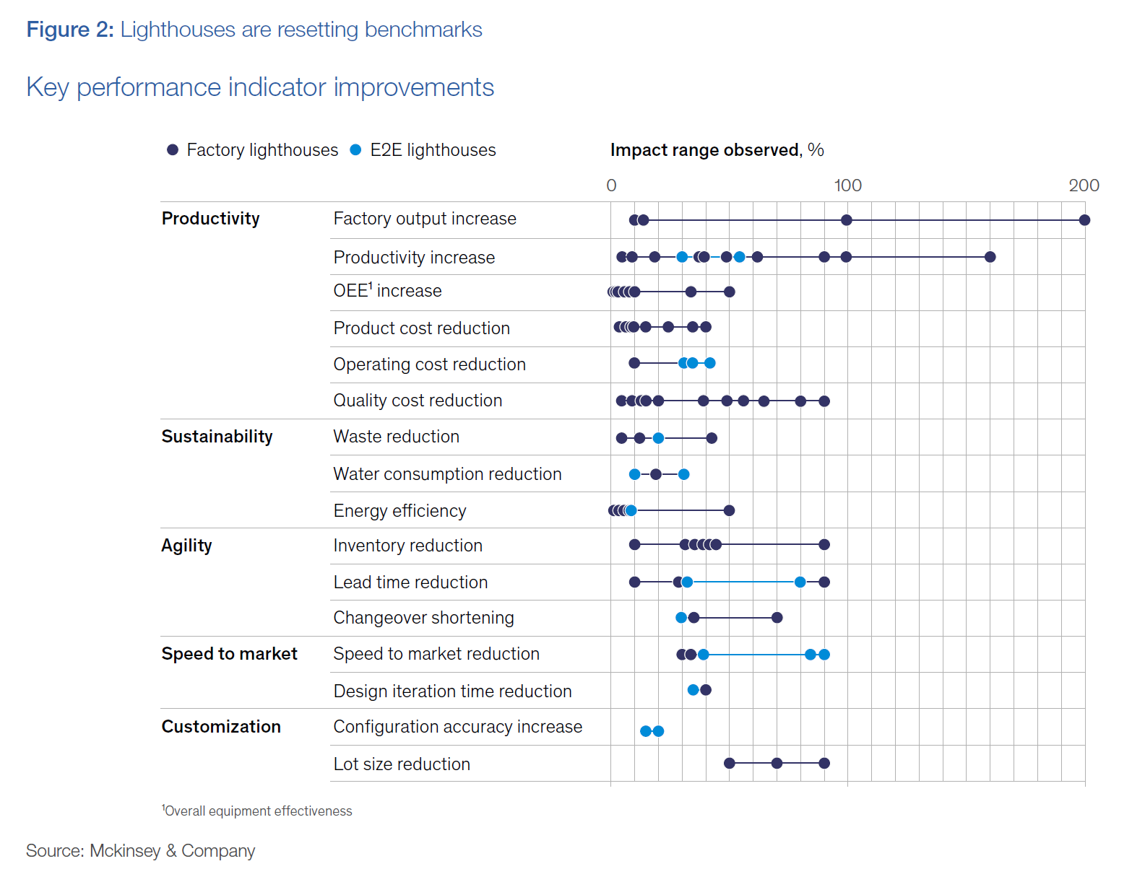
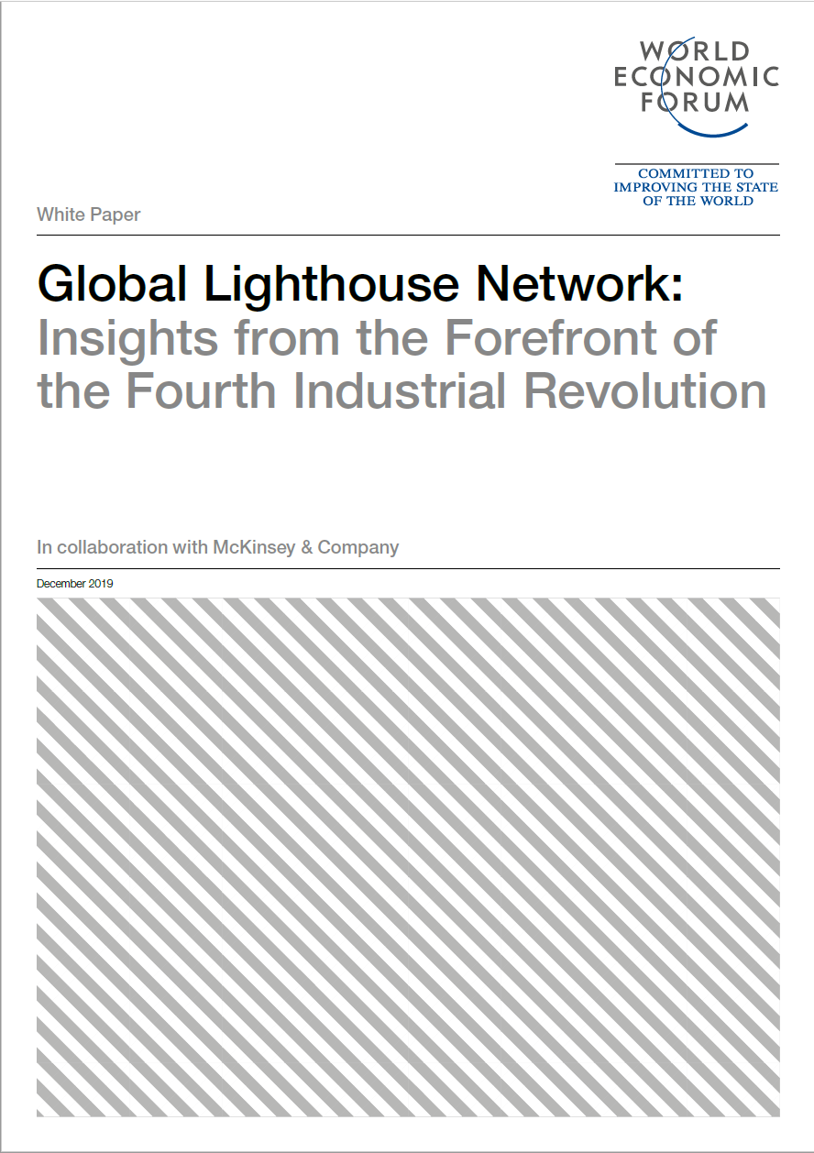
Leaders are simply farther along the value creation journey

Slide 12
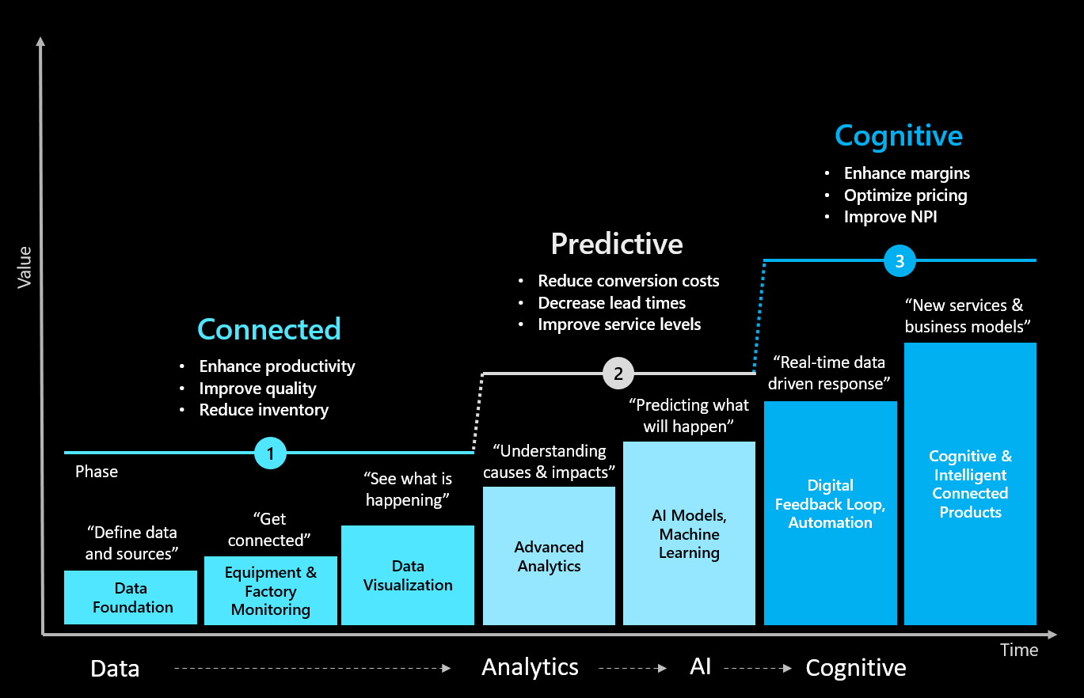
Aligning IIoT/AI to value creation strengthens adoption & ROI
On Time Delivery
Intelligent Supply Chain
Factory of the Future
Efficiency @ High Mix
Execution @ Place / Time
Process Definition “Digital Twin”
Materials Availability
Tool Readiness @Cell
Skilled Labour Availability
Recipe Version @ Operation
Process Version Definition / Bill of Process
Product Version Definition “Digital Twin”
Material Sequencing
Fast Changeover
Fast Calibration
Automated / Augmented
Closed Loop Feedback
Task Assistance
Real Time Sequencing
Timing/Problem Reporting
Real Time Sequence Changes
Auto Adjustment
Robotics / Automation
Material Delivery
Material Location Tracking
Automated Inventory Usage
Capacity
Options & Variant Management
Advanced Sequencing
Task Execution Tracking
Track & Trace
Machine Downtime Reporting
Task Execution TAKT Reporting
In Process Quality Checking
Zero Defect Quality
Detection
Containment
Mixed Reality
Process Guides
Automation Program
Task Guidance
Training
Scheduling
Expert Assistance
AI Assistance
Electronic Work Instructions
AI / Bot Assistance
Remote Assist
Agility at Scale Focus
Inventory Tracking
Config Management / PLM
BoM Management
CAD/CAM/CAE Data Management
Real Time Feedback
Fast Dial In
Signature Prediction / AI
AI / Machine Teaching Algorithms
Signature Analysis
Auto Containment
100% Inspection
Physics-Based Process Simulation
Real Time Process Data
Physics-Based Simulation Model
Real Time Controls / Sensor Data
Automated Inspection
Anomaly Detection
Vision / Data AI
IoT/Data Platform
Machine Connectivity
Shift Tracking
MRP/ERP
Forecasting
Training Data
Process Signature
Virtual Commissioning
Process Simulation / HiL / SiL
SCADA / Sensor / IoT Data
Solving Agility at Scale: “High Mix @ High Volume”
Engineering Productivity
Big Compute / HPC
Supply Chain Efficiency
Intelligent Supply Chain
Factory Flexibility
Factory of the Future
Workforce Effectiveness
Workforce Transformation Connected Field Services
Quality Improvement
Factory of the Future

Slide 13
Thank you for your time
Michael Gardiner, P.Eng
michael.gardiner@microsoft.com

